Slide 1



High School Redesign and Financial Literacy in DC Public Schools
April 2023
Notes:
PH
Introduce PH, joined by RDs from two of our redesign schools.

Slide 2
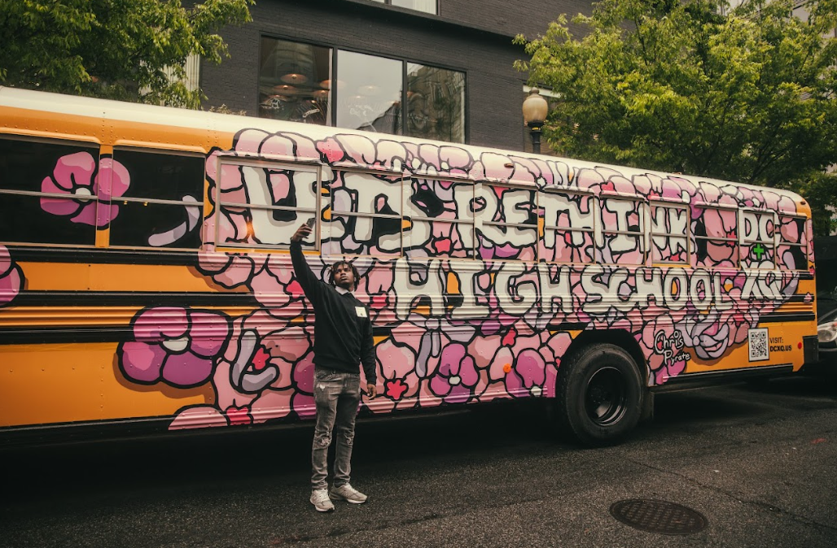
Session Goals
Understand the DCPS High School Redesign process & ways it is promoting a focus on financial literacy
Hear from Cardozo HS about their process, bold ideas, and current work
Provide input and feedback to improve process, engagement, and concepts and understand opportunities to get involved
Notes:
PH
In our brief time together, we hope to… (read goals)

Slide 3


1
What is Redesign?
Notes:
PH

Slide 4

What is Redesign?

Slide 5
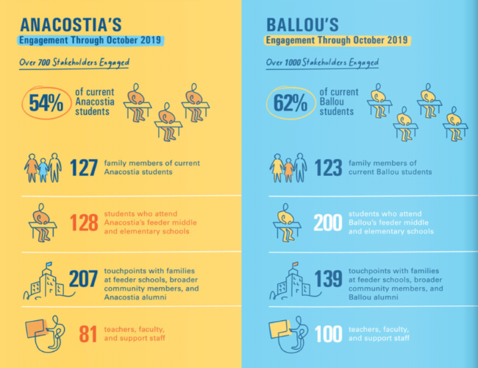
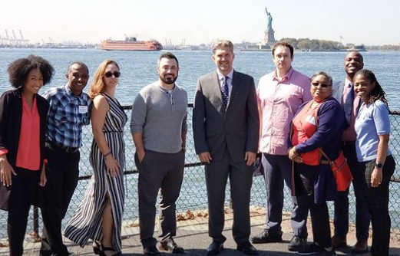
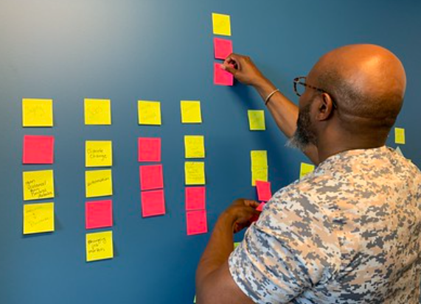
Redesign’s Beginnings
Notes:
PH
SAY: As a quick refresher, Redesign began as a transformation effort as a result of OSSE STAR rating where Ana & Ballou each spent a year engaging with their community, ideating ways to improve the student experience and landing on new school models. During this year teachers were stipended to participate in pilots, some became members of the teacher task force, some went on inspiration visits to learn from other schools, and others engaged in professional development on and off site.
From that year, from the feedback from their teachers, they each landed on 3 big bets grounded in community voice that they launched in Fall 2020 and continue to learn from and grow each year.
From our early wins and learning with Anacostia and Ballou High School, we have been really excited and grateful that through a new partnership with The XQ Institute more high schools will be able to engage in redesign.
~2 min~

Slide 6
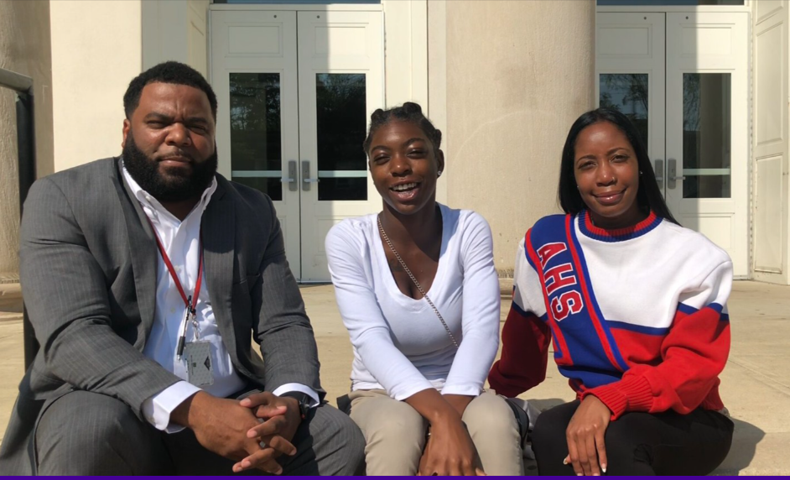
Redesign’s Beginnings
Parents and students are eager for more engaging and real-world learning experiences
Students and parents want opportunities to prepare for both college AND career
Over 85% of observed lessons & artifacts were not aligned to grade-level expectations
Teachers want more resources & development opportunities for relevant & rigorous learning, responsive to their students' need and school context
Stakeholders underscored the importance of addressing student trauma and social emotional needs

Slide 7
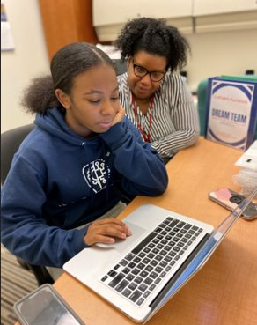
Redesign's Beginnings
Anacostia High School​ | Ballou High School​
Project-Based Learning to support themes of environmental and social justice​ | Case Study Methodology to support theme of entrepreneurship​
Increase in career pathway options and access for students, including an added Civil Engineering and Architecture Pathway​ | Increase in career pathway options and access for students, including an added Computer Engineering & IT Pathway​
A “Dream Team” of caring adults for each student​ | Healing-Centered Practices in every classroom​

Slide 8
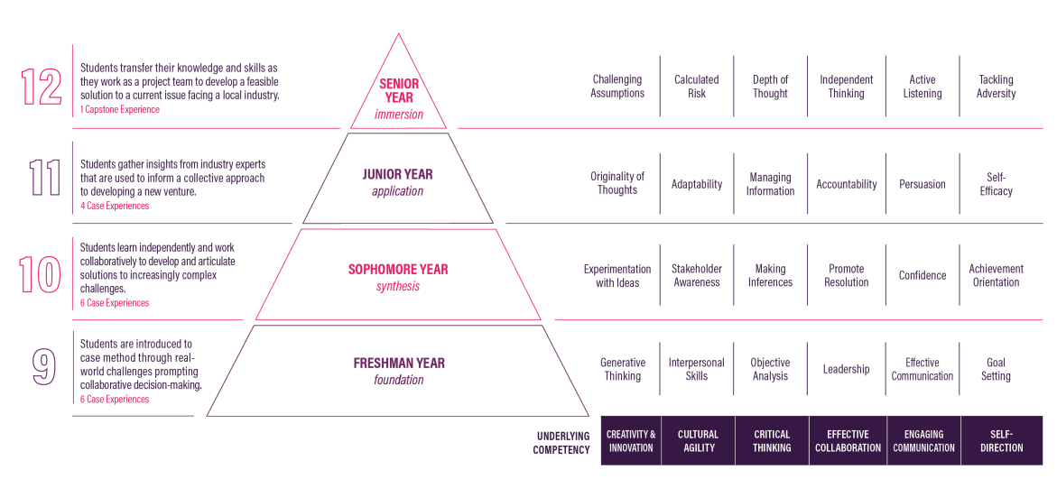
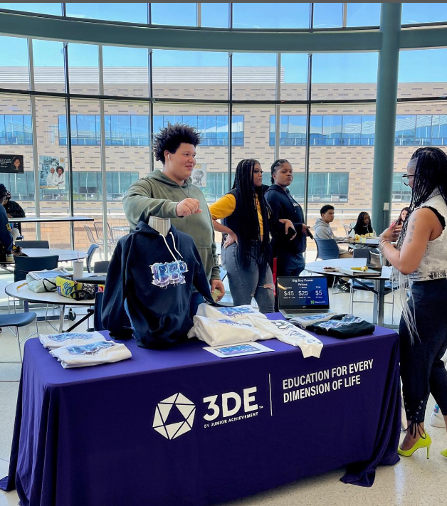
3DE & Junior Achievement

Slide 9
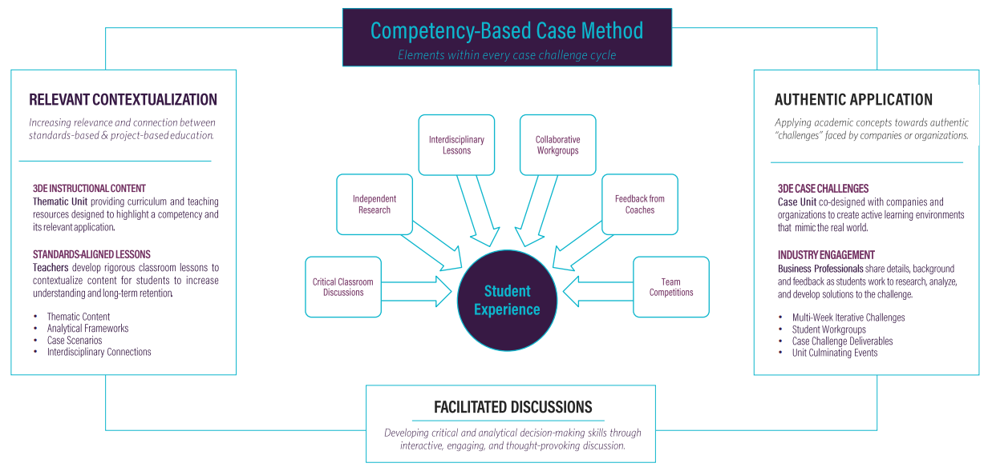
3DE & Junior Achievement

Slide 10
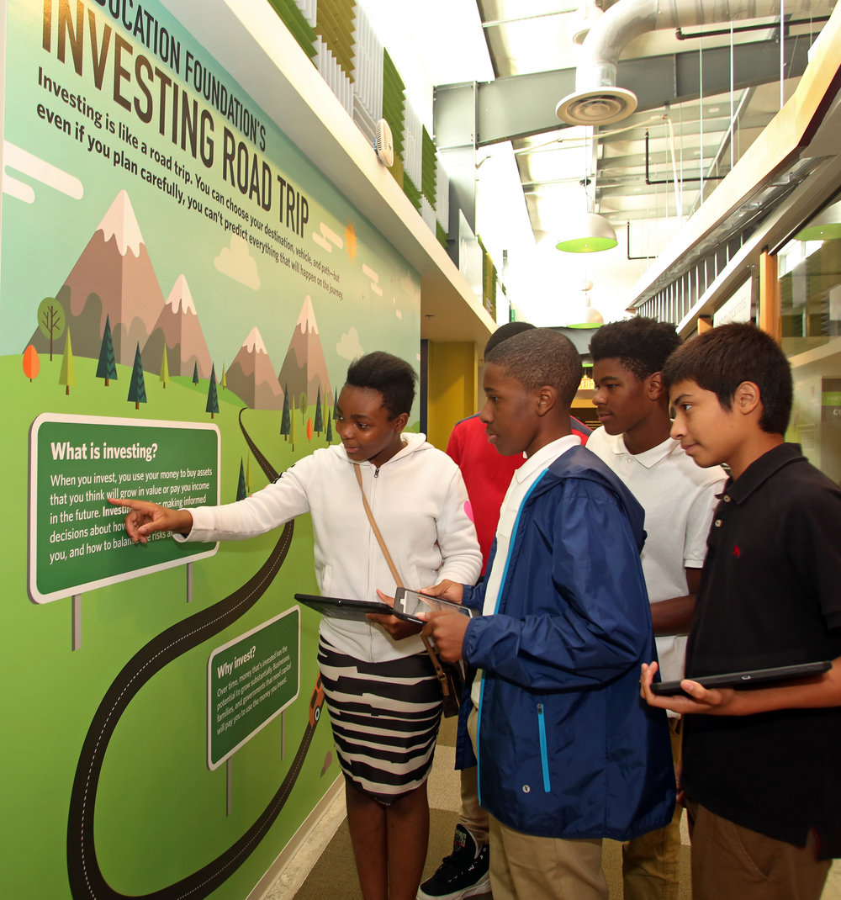
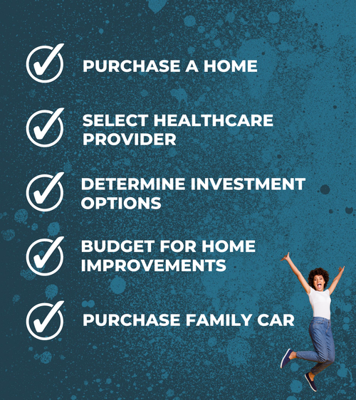
Junior Achievement Finance Park

Slide 11
2
What is DC+XQ?

Slide 12
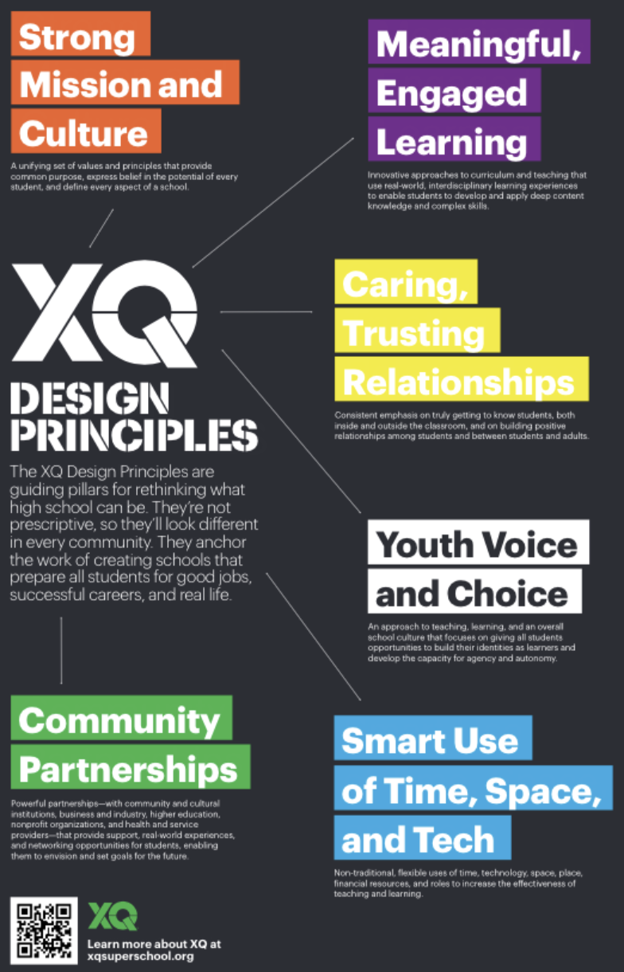
XQ
America needs high schools that prepare students for the future. And there’s no time to waste. Let’s do this, together.
XQ Institute is the nation's leading organization dedicated to rethinking the high school experience so that every student graduates ready to succeed in life.
XQ partners with schools and communities across the country to boldly reimagine what is possible for high schools using qualitative and quantitative data and the power of the community.
XQ’s design process and materials, based on research and design thinking, empower people to take up the challenge of transforming their high schools.
XQ always supports the vision of our partners, ​​so every school they work with is unique. What they all share is a commitment to equity and fairness through a set of design principles that center students.

Slide 13
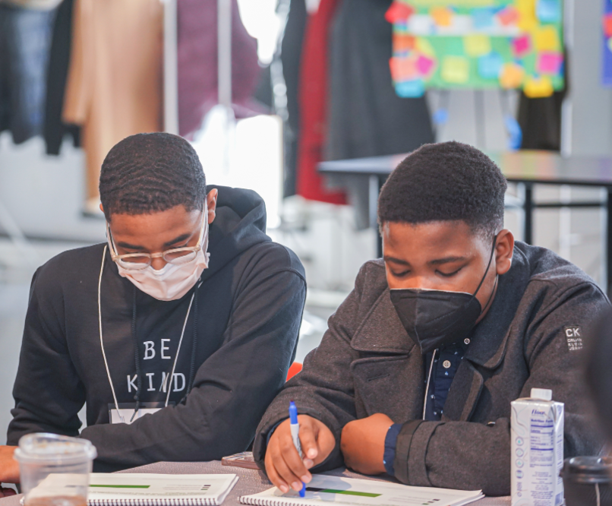
DC + XQ
DC+XQ is a districtwide, multi-year, community-driven campaign to rethink what high schools can be for all students in DCPS.
DC+XQ will mobilize the entire D.C. community to come together and join local design teams. This campaign is an open invitation to people from every community and from a range of backgrounds and experiences to get involved.

Slide 14
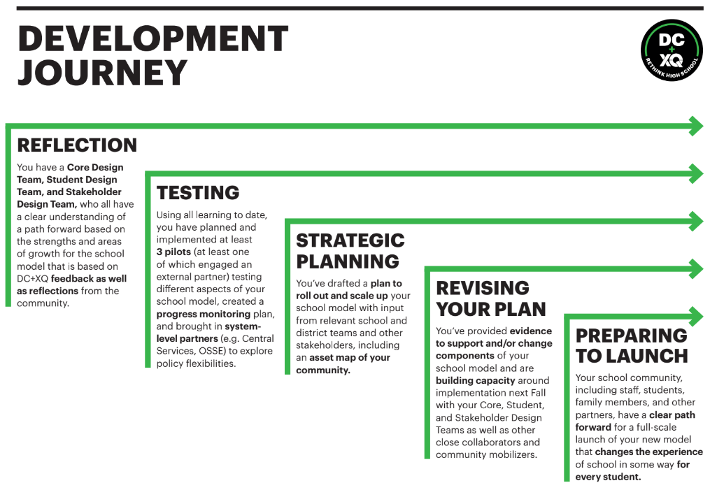

Slide 15
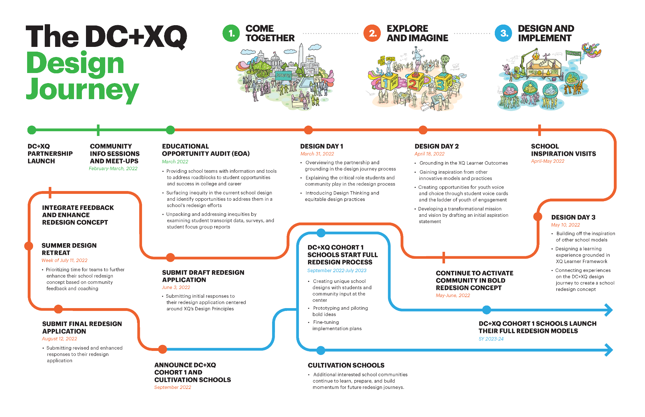

Slide 16


DC + XQ Cohort 1 Schools
Francis L. Cardozo Education Campus will redesign their school around financial literacy, work-based experiences, and entrepreneurship, with opportunities for all students to graduate as small business owners.
Paul Laurence Dunbar High School will redesign their school to embrace Afrofuturism through culturally relevant curricula and project-based learning, with opportunities for students to use the city and the metaverse as a classroom.

Slide 17
3
How is Cardozo High School promoting economic empowerment?
Notes:
PH

Slide 18
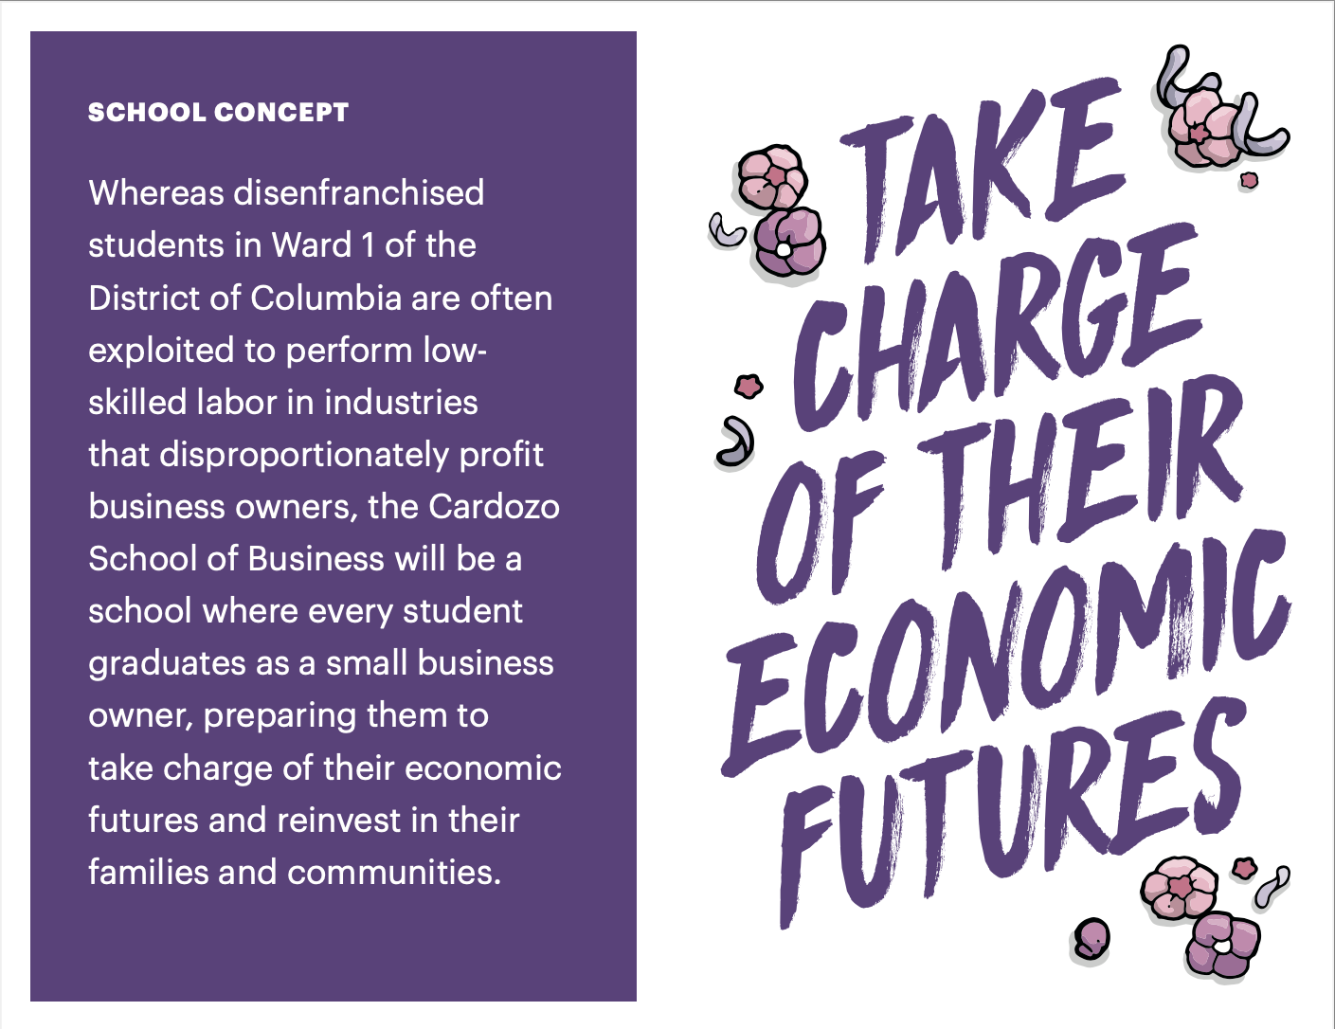
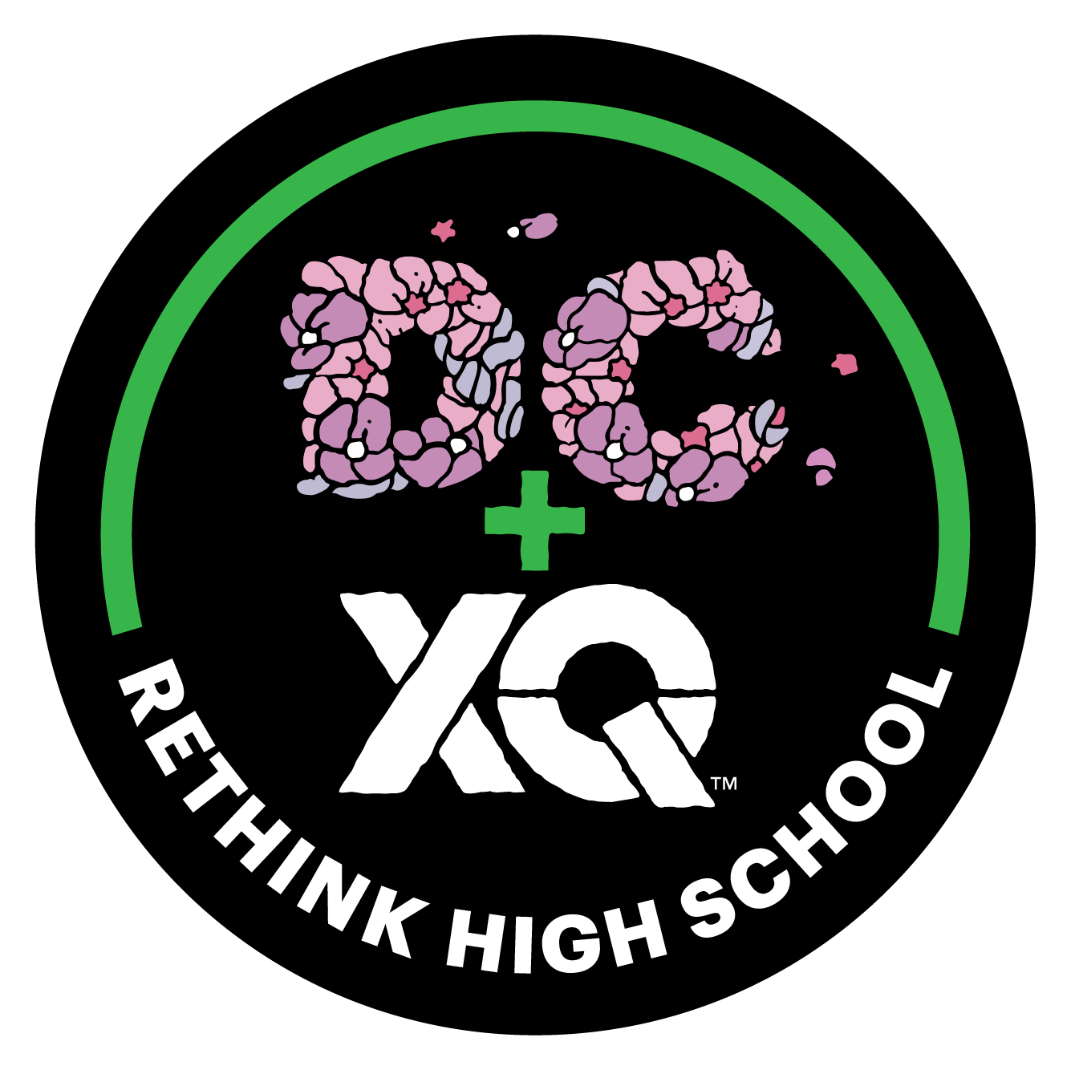

Slide 19
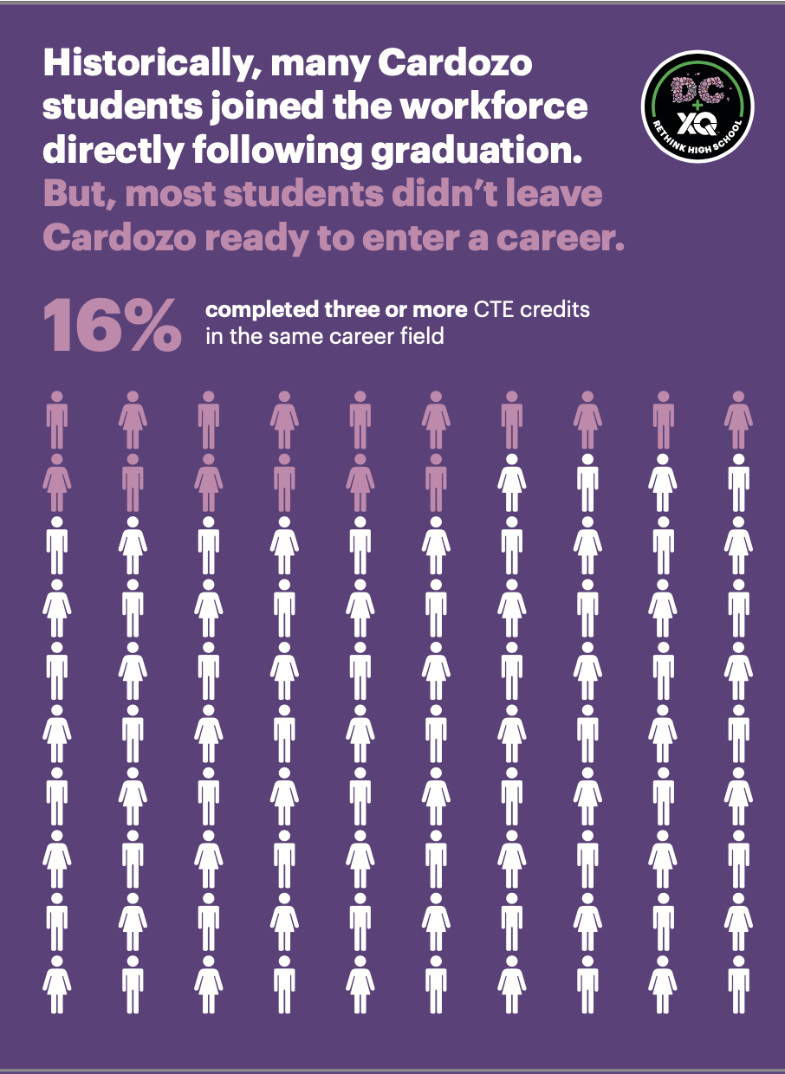
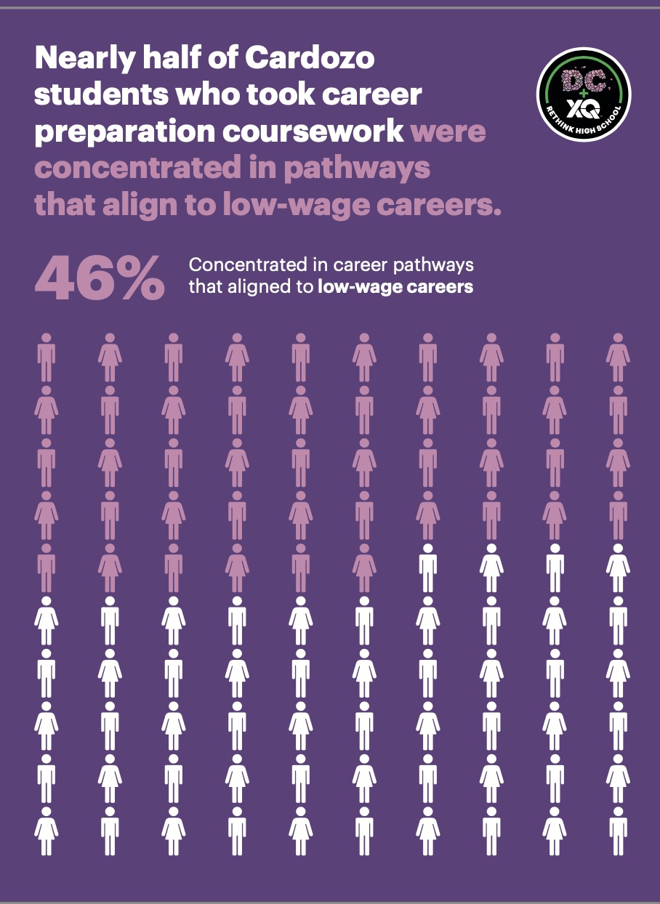

Slide 20
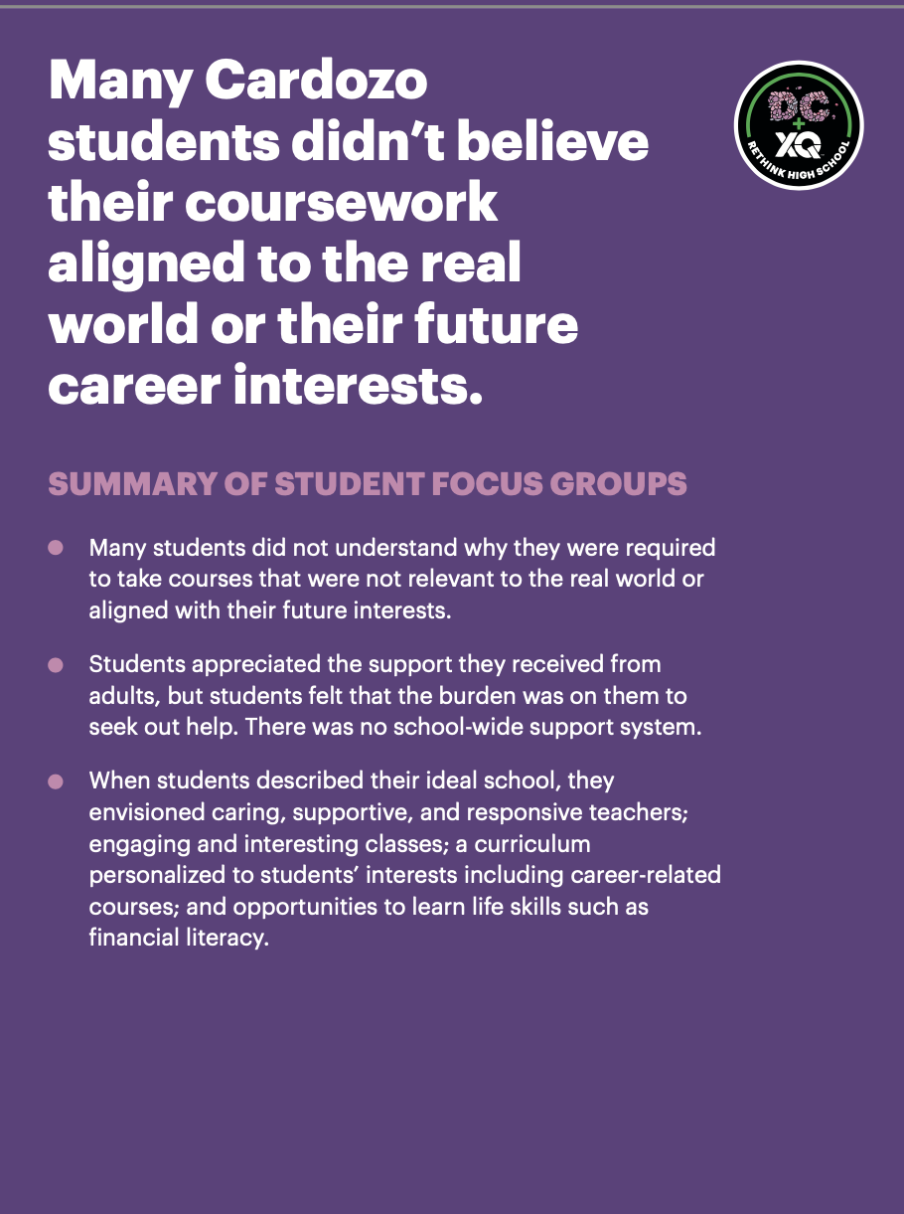
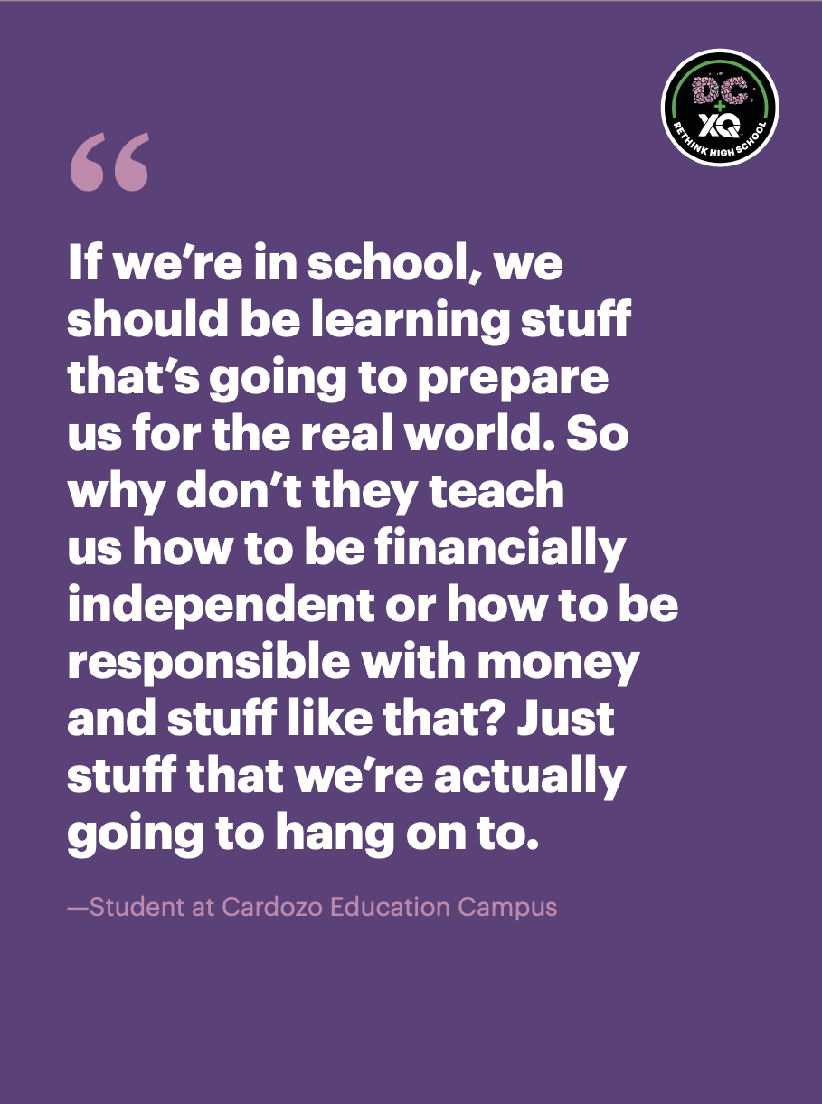

Slide 21
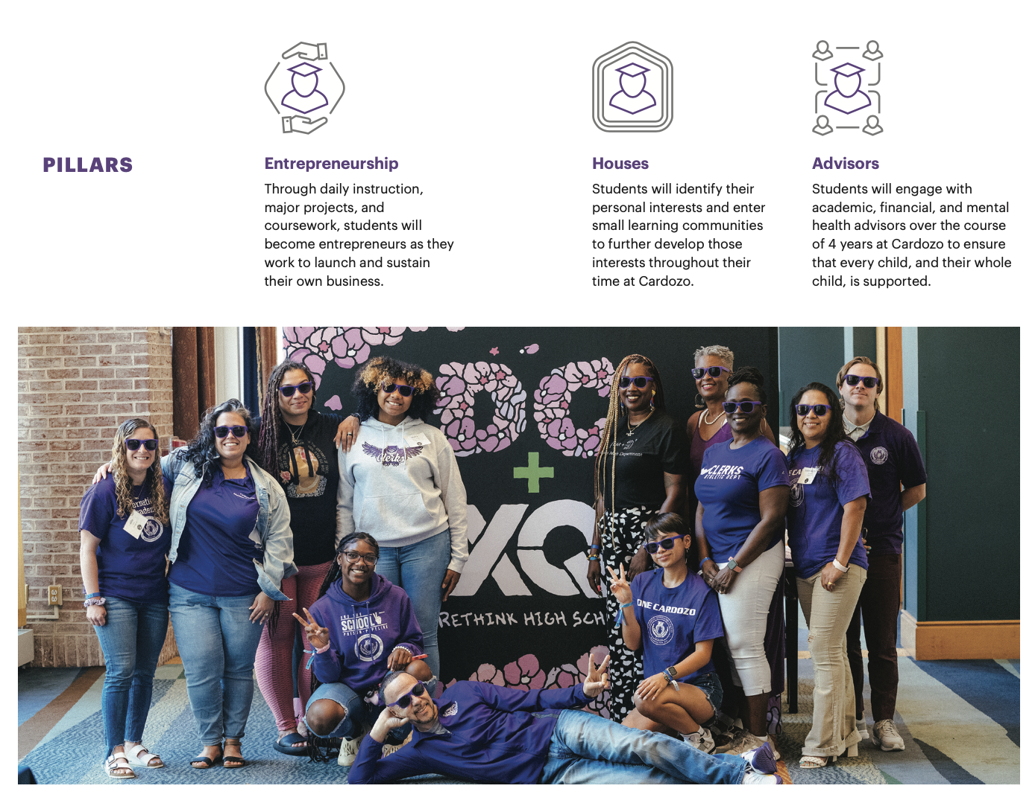

Slide 22
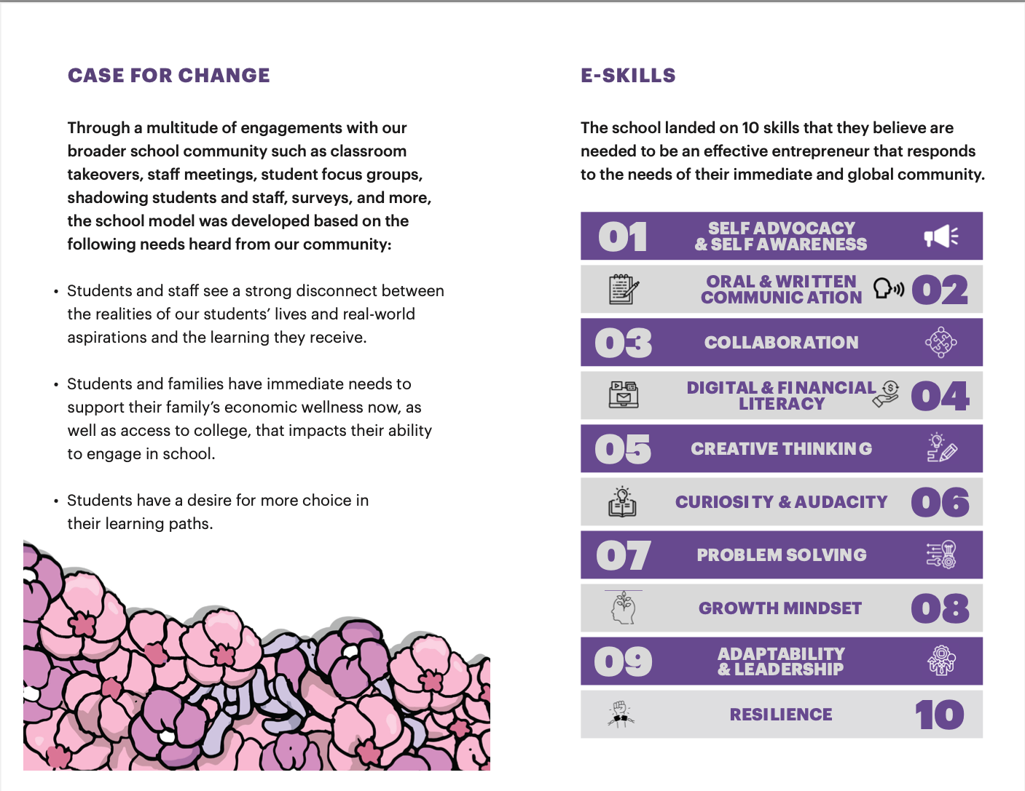

Slide 23
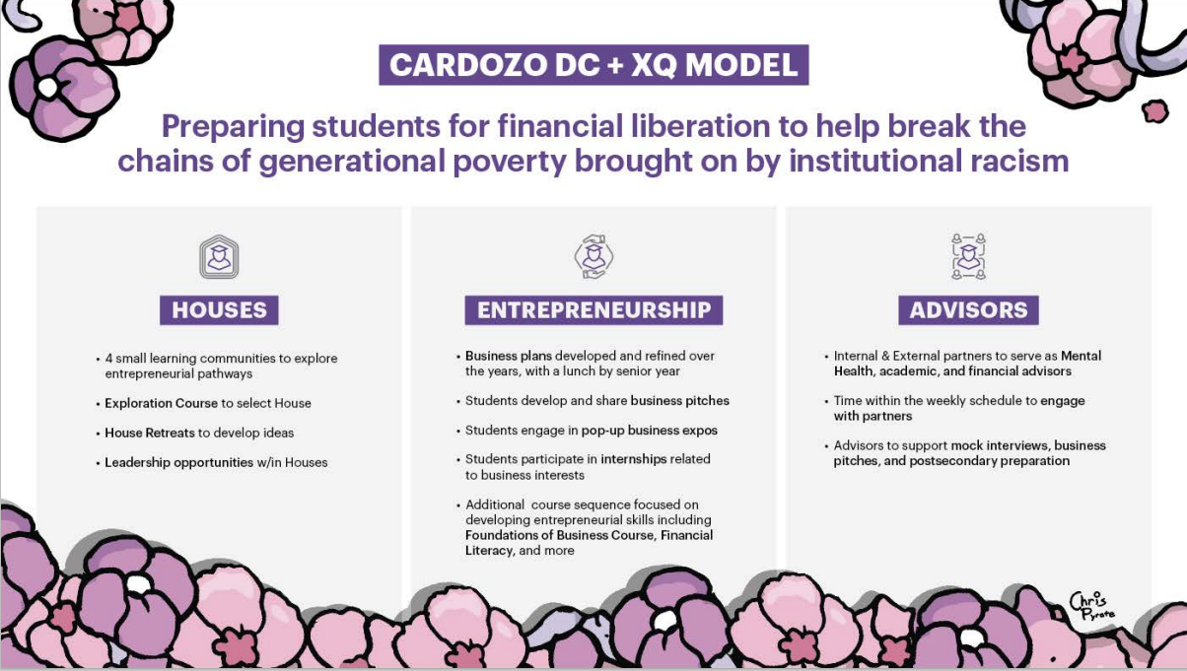

Slide 24
DC + XQ Cohort 1
Schools: Cardozo
Grade Level Meetings
Co-creating pilots w/ teachers & students
Working Groups to further define the E-Skills
Faculty Meetings with students and faculty
1-1 Empathy Interviews
More than 130 current faculty, 150 feeder school community members, 100 community members including parents and alumni, and 90 students were engaged between September – December 2022 to provide feedback on school model
Notes:
SAY: During the journey, we mentioned the empathy work core teams did to hear directly from a variety of stakeholders as they were first developing their bold idea. That initial push of empathy work with stakeholders to inform the overall school concept did not end with the initial engagement on the concept, it continued during the reflection phase, as you can see here.
DO: click
SAY: Specifically, both schools have been very focused on engaging with their school staff. Cardozo has engaged with teachers in a variety of ways– they held a faculty meeting where students came to directly talk to the staff about the use of time in the classroom. The RD is also regularly joining grade-level meetings to understand the current challenges facing staff and engaging them in brainstorming what are the necessary steps and supports needed to get from our current reality to the vision. In addition, teachers and staff had the opportunity to join working groups to definitions and eventually, look fors, for the e-skills, while other teachers are co-creating pilots to integrate the e-skills thi
~2 min~

Slide 25
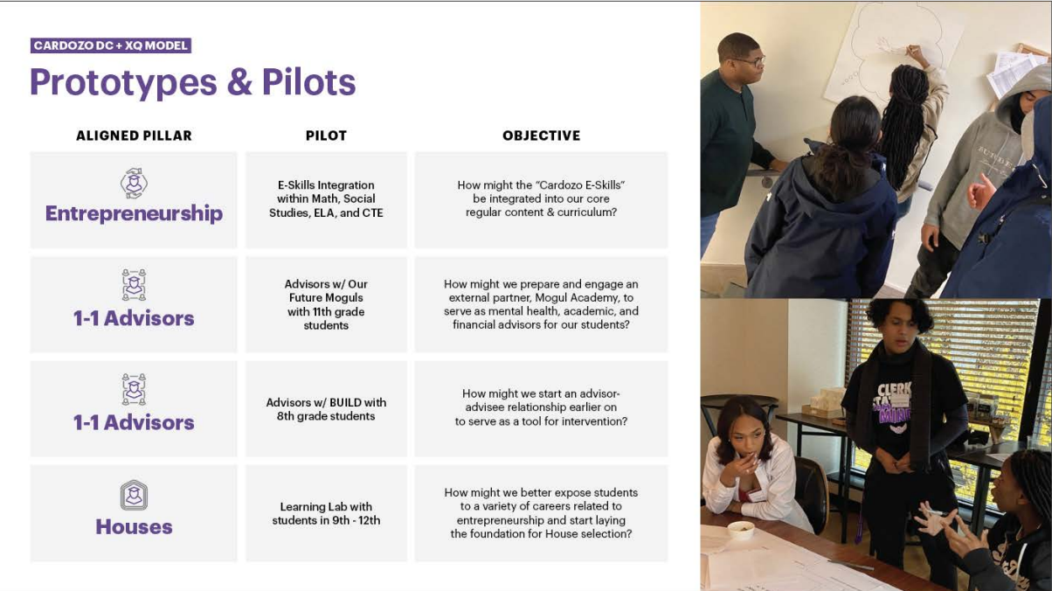

Slide 26
Expected Student Outcomes

Slide 27
Student Enrollment
Student Attendance
Experiential Learning Opportunities
Rigorous Interdisciplinary Learning
College & Career Readiness

Slide 28
Opportunities for Involvement
Learning Lab Fridays
9:00am – 10:30am
Student Programming (Financial Litearcy)
Financial Advisors (Students)
Entreprenuership Exposure
Learning Lab Fridays
Provide students 90 min of exposure to financial literacy and/or entrepreneurship experiential learning
Engage students as financial advisors to elevate their knowledge around financial literacy
Expose students to resources that empower them to take control of their economic futures

Slide 29
4
Q&A
Notes:
SS

Slide 30
5
How can you stay involved?
Notes:
SS

Slide 31
How to Stay Involved
Cardozo | Follow us on Twitter @CardozoEC Follow us on Instagram @Cardozo_EC Connect with the Redesign Director via email: William.Blake@k12.dc.gov
Design Lab | Follow us on Twitter & Instagram @DCPSLab Visit our website at https://dcps.dc.gov/page/design-lab Email design.lab@k12.dc.gov with any questions

