Slide 1
FINRA’s Commitment to Investor Education

Slide 2
Who We Are
FINRA is largest independent, non-governmental regulator of brokers and brokerage firms
Created under federal law (Maloney Act of 1938)
Works in partnership with, and is overseen by, SEC
Mission:
Investor protection
Market integrity
Notes:
independent, non
-
governmental
regulator for all securities firms doing business with the public in the United
States. FINRA works to protect investors and maintain market integrity in a
public
-
private partn
ership with the Securities and Exchange Commission (SEC),
while also benefiting from the SEC’s oversight. In its role as investor guardian,
FINRA is informed, but not influenced, by the industry that it regulates. FINRA’s
independent regulation plays a cri
tical role in America’s financial system
—
all at
no cost to taxpayers.

Slide 3
What We Do
FINRA touches virtually every aspect of the securities business
Registering and licensing industry participants
Examining securities firms for compliance with rules
Enforcing those rules and federal securities laws
Informing and educating investing public
Providing trade reporting and other industry utilities
Notes:
FINRA touches virtually every aspect of the securities business—from registering and educating industry participants to examining securities firms; writing rules; enforcing those rules and the federal securities laws; informing and educating the investing public; providing trade reporting and other industry utilities; and administering the largest dispute resolution forum for investors and registered firms. It also performs market regulation under contract for The NASDAQ Stock Market, the New York Stock Exchange, the International Securities Exchange, BATS and the Chicago Climate Exchange.

Slide 4
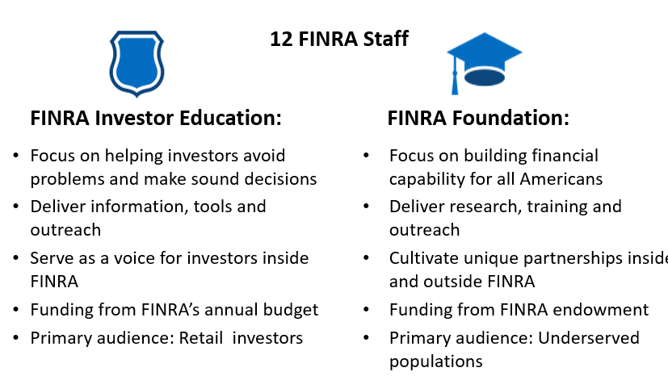
FINRA Investor Education and the FINRA Investor Education Foundation
Notes:
FINRA touches virtually every aspect of the securities business—from registering and educating industry participants to examining securities firms; writing rules; enforcing those rules and the federal securities laws; informing and educating the investing public; providing trade reporting and other industry utilities; and administering the largest dispute resolution forum for investors and registered firms. It also performs market regulation under contract for The NASDAQ Stock Market, the New York Stock Exchange, the International Securities Exchange, BATS and the Chicago Climate Exchange.

Slide 5
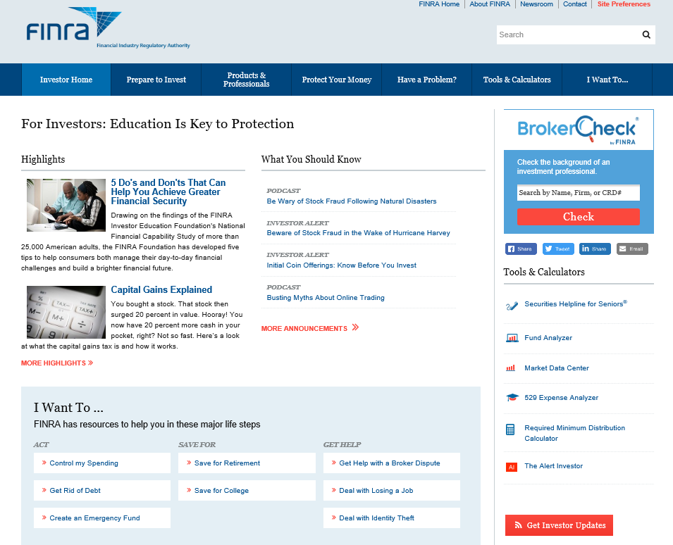
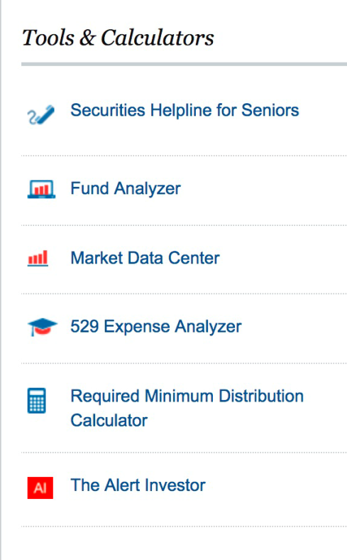
Public Resources: FINRA.org/Investors

Slide 6
Investor Alerts
Driven by listening to investors, regulatory landscape, media, partners
Topics range from topical to general
Urgent (911) and Good to Know (411)
Beware of Stock Fraud in
the Wake of Hurricane Harvey
Inherited IRAs—What You Need to Know

Slide 7
Investor Helpline
Handle investor calls in tandem with Senior Helpline
We hear real issues, in real time
We can provide unbiased information on specific issues (staff prohibited from giving investors advice)
Gather regulatory intelligence
“Normally I’m extremely cautious when it comes to investing. But in this case, I was desperate and wanted to believe [the people who called me].
I want everyone to know these people are incredibly clever – and to be warned.”
– Catherine Mulholland, Investor Grafton, NH

Slide 8
FINRA Investor Education Foundation: Reach, Educate, Protect
Protect consumers from financial fraud and ameliorate the consequences
Advance military financial readiness
Foster sustainable financial education in the community and at the workplace
Track, understand and communicate Americans’ financial capability
Optimize the Foundation’s human, social and financial capital

Slide 9
Employer-Sponsored Small-Dollar Loan
Borrow Now. Prepare for Tomorrow.
A Smarter Small-Dollar Loan

Slide 10
Employer-Sponsored Small-Dollar Loan
Up to $2,000 based on ability to repay
Borrowers may only have one loan at a time
Terms range from 90 days to 12 months
15.99% to 17.99% APR
No borrower fees

Slide 11
Employer-Sponsored Small-Dollar Loan
Simple application
Money often available on the same day
Repaid through payroll deduction
Repayment reported to credit bureaus
After repayment, deduction continues on opt-out basis and deposited into participant’s savings account

Slide 12
Employer Commitment
Small annual fee, based on the number of employees
Market the program to employees
Confirm applicant eligibility
Set up payroll deduction
Inform lender if a borrower separates from the company

Slide 13
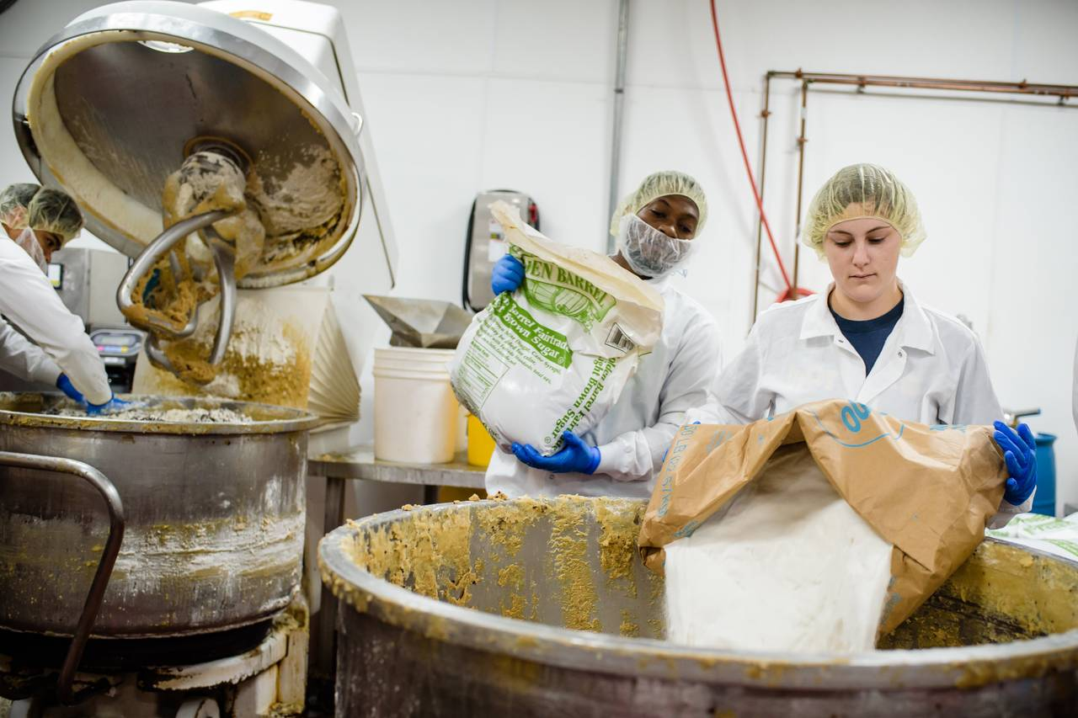

Slide 14
Accessible Financial Services Incubator
13 financial institutions
8 states
48 employers
More than 1,000 loans totaling $1.2 million
Employee savings of $42,000 after loan repayment

Slide 15
Accessible Financial Services Incubator
Average loan: $1,173
Average savings after repayment: $152
Typical borrower:
39 years old
$36,474 annual income
Credit score of 554

Slide 16
Results for Financial Institutions
“We were looking for a way to assist existing members with subprime credit and to attract new members. This program is helping us accomplish both objectives.”
Cheryl Dorman, CEO and Treasurer-Manager
Mercy Health Partners Federal Credit Union, Toledo, Ohio
“The program will help us reach a large pool of borrowers and build new business relationships. It is a win-win for the bank, our nonprofit and business partners, and local employees.”
Melanie Stern, Director of Consumer Lending
Spring Bank, New York, New York

Slide 17
Employer Outcomes
Easy to implement and popular with employees
Employers planned to continue offering the loan
All employers would recommend the program to others
Employers offering 401(k) plans credited the ESSDL with reducing withdrawals and loans from retirement savings

Slide 18
Borrower Satisfaction
The loan program helped me meet my emergency needs 4.86
The loan was fairly priced 4.58
My financial position improved because of this program 4.04
I would take out another loan if the need arises in the future 4.82
I would recommend this program to my family and friends 4.74
1=Strongly disagree, 2=Disagree, 3=Neutral, 4=Agree, 5=Strongly Agree

Slide 19
Additional Findings
The ESSDL program is customizable
Underwriting
Loan purpose
Naming and branding
Collaboration with a community-based nonprofit may enhance uptake and implementation

Slide 20
Turn-Key Implementation Tools
Filene.org/ESSDL

Slide 21
FINRA’s Commitment to Investor Education

