Slide 1
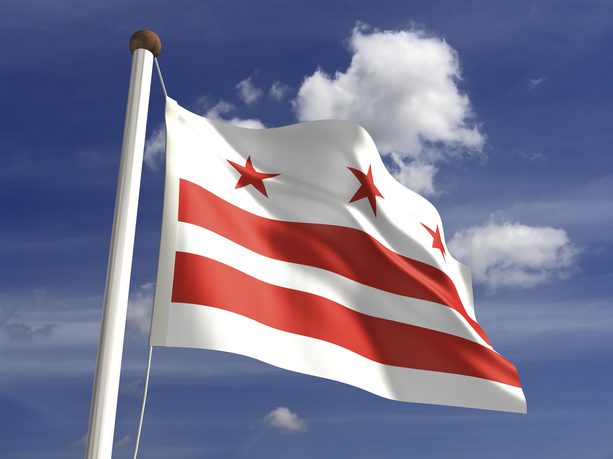


Protecting Your Financial Interests
Date
Karima M. Woods, Commissioner

Slide 2


What is Project REACh
REACh (Roundtable for Economic Access and Change)
Brings together leaders from banking, business, technology, and national civil rights organizations to reduce specific barriers that prevent full, equal, and fair participation in the nation’s economy.
The Office of the Comptroller of the Currency (OCC) recognizes that removing structural barriers to financial inclusion will result in broader participation in the economy and will help millions of people, previously left out of the system, to pursue their American dreams
Financial empowerment is closely linked to broader positive socioeconomic outcomes, and fuller economic participation can improve the lives of those directly affected.
2 | DC Department of Insurance, Securities and Banking

Slide 3
Areas of Focus
Credit Counseling and Repair
Nearly 50 million people in the United States have no usable credit scores, making credit less accessible and more expensive for them. Project REACh participants are exploring ways to address credit standards and counsel and educate residents on how to build, repair and sustain positive credit.
Affordable Homeownership
Homeownership is a major pathway to building wealth. Project REACh participants seek to expand homeownership opportunities, reduce and address issues with unaffordable housing for District residents.
Small Business
Small businesses serve as engines for the economy, but resources to support their expansion are limited. Project REACh focuses on collaborative efforts to build and support entrepreneurs by focusing on access to capital, technical assistance and procurement opportunities to minority-owned business enterprises and entrepreneurs.
2 | DC Department of Insurance, Securities and Banking

Slide 4
How Will We Achieve It
We are developing a list of the top barriers facing individuals and small business around the area’s below:
  Small Business: Technical Assistance, Procurement Opportunities & Access to Capital
  Obtaining and maintaining affordable housing
  Credit
Obtain data on the identified barriers to determine the following:
  In what ways does this issue affect people
  What present solutions are available to residents
  What solutions need to be developed
Create Program, Products and/or Policy recommendations that help to bridge the wealth gap for minority individuals and businesses in the District.
2 | DC Department of Insurance, Securities and Banking

Slide 5







How to Learn More
disb.dc.gov
Youtube.com/DCDISB
202-727-8000
@DISBDC
disb@dc.gov
@DCDISB
@DCDISB
2 | DC Department of Insurance, Securities and Banking

