Slide 1
MENTAL HEALTH PARITY & SUBSTANCE USE DISORDERS PRESENTATION
Jean Harris, President & Interim Executive Director
National Alliance on Mental Illness DC (NAMIDC)
District of Columbia Department of Securities Insurance and Banking (DISB)
May 12, 2022

Slide 2
A school of fish were swimming together upstream. Coming in the opposite direction was a more mature fish. As he swam past he said, “Hi boys enjoying the water today?” After he passed, one fish said to another, “What’s water?”
The lesson here is do not assume that everybody knows or understand, or come from the same frame of reference!

Slide 3
1979-2022
1979 NAMI started with family members with children living with serious mental illness, who believed then they were entitled to equal service and care.
1981 NAMIDC became one of the early affiliates of the national organization.
2022 NAMI is the largest grassroots, non-profit organization providing education, support and advocacy. And, still believes in equal care and service.

Slide 4
1992
NAMI membership appeared at the U.S. Capital with 1.5 million petitions calling for mental health parity.
Senator Pete Domenici (R-NM), a NAMIDC Member at the time, introduced the first federal mental illness parity bill.

Slide 5
1996
Mental Health Parity Act was signed into law ending discriminatory annual lifetime ceiling limits for mental health care.

Slide 6
2008
Senator Paul Wellstone (D-MN) and Senator Domenici introduced the Mental Health Parity and Addiction Equality Act which was signed into law.

Slide 7
2010
Under the Obama Administration, the Affordable Care Act (ACA) was enacted offering protection for people with pre-existing conditions including people with mental health and substance use disorders.

Slide 8
Essential Health Benefits Act
Essential Health Benefits Act required in the ACA changed mental health and substance use treatment coverage. This law expanded coverage to address the lack of parity for individuals with mental health and substance use disorders.

Slide 9
Mental Health
Mental health and substance use disorders affect millions of Americans:
1 in 5 adults
1 in 25 with serious mental illness
1 in 6 youth from ages 6 through 17 have been identified as having mental health conditions

Slide 10
Conclusion
The health care costs for an individual with these mental health disorders would exceed one’s ability to pay.
Demonstrating the necessity for Parity to work.
26 years later where are we?

Slide 11
THANK YOU!
CONTACT US
TELEPHONE NO.: (202) 546-0646
EMAIL: president@namidc.org
WEBSITE: https://www.namidc.org
Celebrating 44 Years of help and hope!

Slide 12
Increasing Access to Mental Health and Addiction Care Through Enforcement of the Federal Parity Act
David Lloyd
Senior Policy Advisor
david@thekennedyforum.org

Slide 13
Landmark Anti-Discrimination Law
Mental Health Parity and Addiction Equity Act of 2008
Plans CANNOT:
Charge higher co-payments or other out-of-pocket expenses for behavioral health than for physical health. (“Financial Requirements”)
Limit more stringently the number of visits or days for behavioral health services than they do for physical health. (”Quantitative Limitations”)
Use more restrictive managed care practices for behavioral health than for physical health. (”Non-Quantitative Treatment Limitations” -- NQTLs)
Fundamentally, the Federal Parity Act requires a comparison between mental health / addiction vs. medical/surgical coverage
Federal Parity Act is a powerful tool to end discriminatory coverage

Slide 14
State Parity Reporting Requirements
Federal NQTL Rule located at 29 C.F.R. § 2590.712(c)(4)(i)
A group health plan (or health insurance coverage) may not impose a nonquantitative treatment limitation with respect to mental health or substance use disorder benefits in any classification unless, under the terms of the plan (or health insurance coverage) as written and in operation, any processes, strategies, evidentiary standards, or other factors used in applying the nonquantitative treatment limitation to mental health or substance use disorder benefits in the classification are comparable to, and are applied no more stringently than, the processes, strategies, evidentiary standards, or other factors used in applying the limitation with respect to medical/surgical benefits in the classification.
DC (Act 22-568) and 17 States passed parity implementation legislation since 2018 based on model legislation
Requires insurers (and in some state Medicaid MCOs) to submit compliance analyses to state regulators; mirrors requirements in new federal amendments

Slide 15
New Federal Amendments
The Consolidated Appropriations Act, 2021 signed into law on 12/27/2020 amended the Federal Parity Act
Requires insurers and health plans to perform parity compliance analyses
Compliance analyses must be submitted to state and federal regulators upon request
Applies to all private insurers and all group health plans (unfortunately, not to Medicaid MCOs)
42 U.S.C. 300gg–26(a)(8)
Both DC reporting law and federal requirements break down NQTL rule into its component parts for reporting purposes

Slide 16
DOL / HHS Parity Report
Damning Parity Report Released in Late January
Report jointly released by DOL, HHS, and Treasury (though Treasury plays very minor role).
Required by Consolidated Appropriations Act
None of the comparative analyses reviewed contained sufficient information upon initial receipt.
Titles of Employee Benefits Security Administration (EBSA)’s sections are instructive:
“Many Plans/Issuers Were Unprepared”
“All Comparative Analyses Reviewed by EBSA Were Initially Insufficient”
“EBSA’s Comparative Analysis Review Detected Common Problems and Shed Light on Unexamined Plan Terms and Practices”
https://www.dol.gov/sites/dolgov/files/EBSA/laws-and-regulations/laws/mental-health-parity/report-to-congress-2022-realizing-parity-reducing-stigma-and-raising-awareness.pdf

Slide 17
DOL / HHS Parity Report Cont.
EBSA observed several common themes in deficiencies:
Failure to document comparative analysis before designing and applying the NQTL;
Conclusory assertions lacking specific supporting evidence or detailed explanation;
Lack of meaningful comparison or meaningful analysis;
Non-responsive comparative analysis;
Documents provided without adequate explanation;
Failure to identify the specific MH/SUD and medical/surgical benefits or MHPAEA benefit classification/s affected by an NQTL;
Limiting scope of analysis to only a portion of the NQTL at issue;
Failure to identify all factors;
Lack of sufficient detail about identified factors;
Failure to demonstrate the application of identified factors in the design of an NQTL; and
Failure to demonstrate compliance of an NQTL as applied.

Slide 18
DOL / HHS Parity Report Cont.
EBSA has issued 80 insufficiency letters for over 170 NQTLs, requesting additional information and identifying specific deficiencies.
CMS has issued 19 insufficiency letters identifying deficiencies in the comparative analyses and requested additional information to address these deficiencies.
Even despite insufficient analyses, EBSA has so far issued 30 initial determination letters finding 48 NQTLs imposed on MH/SUD benefits violate parity (36 unique NQTLs).
Even despite insufficient analyses, CMS has so far issued 15 initial determination letters to plans and issuers finding 16 NQTLs violate parity.
Examples of parity violations found:
Applied Behavioral Analysis (ABA) therapy exclusions for autism
Exclusion on Medication-Assisted Treatment (MAT) for Opioid Use Disorder
Nutritional Counseling Exclusion for eating disorders
Limitation on Urine Drug Testing
Blanket Pre-certification Requirement for MH/SUD Benefits
EBSA received corrective action plans from 19 plans in response to initial determination letters. These corrective action plans address 36 NQTLs (30 unique NQTLs).
CMS received corrective action plans from 6 plans and issuers in response to initial determination letters. These corrective action plans address 13 NQTLs.
26 plans and issuers so far have agreed to make prospective changes to their plans.

Slide 19
Services Supporting Mental Health and Addiction Recovery
Department of Insurance, Securities, and Banking
May 12, 2022
Mark LeVota, Executive Director
District of Columbia Behavioral Health Association

Slide 20
The District of Columbia Behavioral Health Association advances high-quality, whole-person care for all District residents with mental illness or substance use disorders
Our members collectively deliver services to over 20,000 District residents annually, especially Medicaid beneficiaries

Slide 21
Takeaways Up Front
Behavioral health conditions, including mental illness and substance abuse, are common. Treatment is effective, and recovery is possible.
If you, or someone you know, needs help, there are resources available. These include both peer-to-peer support and clinical care. No one has to wait until they are in crisis to ask for help, and no one should believe something that they consider a crisis will not be considered important to someone else.
Mental health and addiction parity protections are designed to ensure that people can access mental health and substance use treatment to the same extent they can access physical health treatment. These protections have eliminated many quantitative limits, but they are less effective for things not easy to count. Limits to your physical health options may also limit your behavioral health options.

Slide 22
Behavioral Health Service System
Prevention & Early Intervention
Early I.D. & Early Intervention
Pre-Natal Care and Postpartum MH Screenings
Primary Care & Community-Based Treatment
70% seek care in primary care first - Connected to Rx, therapy or treatment
Specialist Services – Mental Health Rehab and SUD Treatment
Residential & Acute Care Treatment
Supporting & Sustaining Recovery
Peer Operated Services and Clubhouse
Supported Employment
Recovery Support Services
Housing First
Harm Reduction Services
Co-occurring support for intellectual, developmental, and cognitive disorders
Improving with co-location of services (Ex: FQHCs) and settings (Ex: Schools)
Hospital Emergency Departments and Hospital Inpatient – PIW and Psych Wards of Community Hospitals
SUD Prevention and MH First Episode Interventions
MH & SUD Residential, Intensive Outpatient Programs (IOPs), and Partial Hospitalization Programs (PHPs)
Long-term Hospitalization at Saint Elizabeth’s
Recovery Housing and Supported Housing
Mobile Crisis, Comprehensive Psychiatric Emergency Program (CPEP), and Crisis Beds
School-Based Services: Tier 1 (Social-Emotional Learning), Tier 2 (Brief Interventions), Tier 3 (Clinical Care)
Criminal-Legal Services: First Responder Crisis Response, Treatment Diversion, Special Drug and Mental Health Court Programs, Healthcare to Incarcerated People, Re-Entry Support
Notes:
ESSENTIAL ELEMENTS FOR ACHIEVING HIGH-QUALITY, WHOLE-PERSON CARE
The general public knows what wellness means, and people at risk for needing care receive targeted prevention support and early intervention if needed.
People are encouraged to seek care they need and have antisocial behaviors recognized as possible symptoms of illness. People who aren’t ready to accept care are provided options to reduce harm they might cause to themselves or others.
People who seek care are easily connected to a provider of their choice.
People receive appropriate care, based on their needs and preferences, in a timely manner. People see value and stay engaged in treatment.
People benefit from their caregivers working to coordinate their care with each other and with others involved in their lives. People whose needs change are supported through transitions to meet their different needs.
People who reach recovery receive support to maintain recovery and are reengaged in care in the event they deteriorate or need to return to care.

Slide 23
Mental Health and Addiction Parity
Access
Network Adequacy
Telehealth

Slide 24
Mental Health and Addiction Parity
Timeliness of Service
Open to New Intake
Length of Waitlist
Time to Intake
Time to Treatment
Benefit Coverage
Inpatient, Outpatient, Emergency, Pharmacy
Service Authorization
Prior Authorization
“Fail First” or “Step Therapy”
Utilization Management and Review
Access

Slide 25
Mental Health and Addiction Parity
Travel Time and Distance
Healthcare Providers Available
Network Adequacy

Slide 26
Mental Health and Addiction Parity
Choice for In-Person or Telehealth
Co-Pays
Provider Payment Rates
Telehealth

Slide 27
Takeaways Again
Behavioral health conditions, including mental illness and substance abuse, are common. Treatment is effective, and recovery is possible.
If you, or someone you know, needs help, there are resources available. These include both peer-to-peer support and clinical care. No one has to wait until they are in crisis to ask for help, and no one should believe something that they consider a crisis will not be considered important to someone else.
Mental health and addiction parity protections are designed to ensure that people can access mental health and substance use treatment to the same extent they can access physical health treatment. These protections have eliminated many quantitative limits, but they are less effective for things not easy to count. Limits to your physical health options may also limit your behavioral health options.

Slide 28
Contact Me
Mark LeVota
Executive Director
District of Columbia Behavioral Health Association
202-929-3757
Mark.LeVota@DCBehavioralHealth.org

Slide 29
DC Government Employees: Mental Health Parity Forum
D.C. Office of Health Care Ombudsman and Bill of Rights
441 4th Street, NW, Suite 250N
Washington, DC 20001
(202) 724-7491
Rev. April 21, 2022

Slide 30
OHCOBR Legislation
The Health Benefits Plan Members Bill of Rights Act of 1998, effective April 27, 1999(D.C. Law 12-274; D.C. Official Code § 44-301.01 et seq. )
Amended November 20, 2012 to comply with the Federal Patient Protection and ACA of 2010, known as the Health Benefits Plan Members Bill of Rights Amendment Act of 2012 (D.C. Act 19-546); and
Strengthened the consumer protection provisions of the District’s internal and external grievance process for health benefit plans.
Notes:
The OHCOBR is governed by two (2) legislative requirements: the Ombudsman’s Program (D.C. Law 15-331

Slide 31
Reasons for Requesting an Appeal
A member or member representative may appeal any “adverse benefit determination” decision resulting in a denial, reduction, limitation, termination, failure to make a payment for a benefit, or a delay of a benefit to a member, regarding determinations about:
The medical necessity, appropriateness, or level of care, or health care setting;
Whether a benefit is experimental or investigational;
A decision to rescind coverage;
A member’s eligibility to participate in a plan;
Whether a wellness incentive has been properly applied; or
Whether the member was given a reasonable alternative standard for satisfying a wellness plan when required.
Notes:
“Rescission” means cancellation or discontinuance of coverage that has a retroactive effect (which is prohibited except in cases of fraud or intentional misrepresentation of material fact).

Slide 32
Appeals for Non-Federal Employees
Employees hired on or after October 1, 1987;
There are two (2) separate appeal levels:
Internal level
Review performed by the insurance company
Two (2) reviews are performed at the internal level – initial and final review
Internal process does not have to be exhausted to pursue an external appeal in cases of emergency expedited cases
OHCOBR staff can assist members in the internal appeals process
Review panel contains at least one medical reviewer that is trained or certified in the same specialty as the matter at issue
External level
Review performed by an independent review organization (IRO);
Conducted by two (2) licensed expert health care professionals that hold the appropriate accreditation or certification for the specialty area under review, with no history of disciplinary action or sanctions pending;
Decision of the IRO is binding on the plan or issuer and the member
Win or lose, the insurance company has to pay for the external review
Notes:
72 hours for emergency cases

Slide 33
Appeals for Federal Employees
Employees hired before October 1, 1987, are eligible to participate in the Federal Employee’s Health Benefits Program (FEHB), which is administered by the US Office of Personnel Management;
There are two (2) separate appeal levels:
Internal level
Review performed by the insurance company
Two (2) reviews are performed at the internal level – initial and final review
OHCOBR staff can assist members in the internal appeals process
External level
Review performed by US Office of Personnel Management (OPM) once internal appeals are exhausted;
OPM will conduct the review, but if medical expertise is required, OPM will seek the opinion of a contracted Independent Review Organization (IRO)
In most cases, OPM will reach a decision within 30 days

Slide 34
Expedited Appeals Process
For the purposes of expedited external review, the Director, or the Director’s designee, shall apply the judgement of a prudent layperson that possesses an average knowledge of health and medicine to determine if other requests involve an emergency or urgent medical condition.
The independent review organization shall complete its review and issue its recommended decision as soon as possible in accordance with the medical exigencies of the case.
The independent review organization shall complete its review within 72 hours in the case of an expedited appeal, from the time the Director assigns the appeal to the independent review organization.
The insurer shall provide all documentation to the independent review organization within 24 hours of receipt of the notice of approval of the grievance, for an expedited review.
If an insurer does not provide the independent review organization all documentation required within the time frames, or obtain the necessary extensions, the independent review organization may decide the appeal without receiving the information.
The independent review organization shall extend its review for a reasonable period of time as may be necessary due to circumstances beyond its or the insurer's control, but only when the delay will not result in increased medical risk, including increased mental health risk, to the member.
In such an event, the independent review organization shall, prior to the conclusion of the initial review period, provide written notice to the member or member representative and to the insurer setting forth the status of its review and the specific reasons for the delay.
Expedited appeals shall be furnished:
For appeals concerning admission, availability of care, continued stay, or health care service for which the member received emergency services but has not been discharged from a nursing facility;
When the member is seeking care for an emergency or urgent medical condition; or
When the insurer’s denial of coverage is based on its determination that treatment is experimental or investigational; which expedited review shall be conducted upon the treating physician’s certification that treatment will be significantly less effective if not promptly initiated.

Slide 35
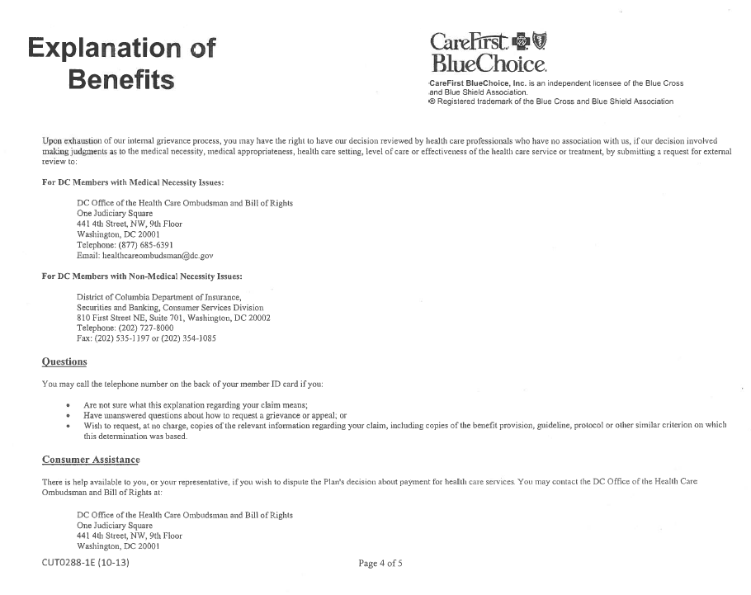
Required Notice to Member from Insurer

Slide 36
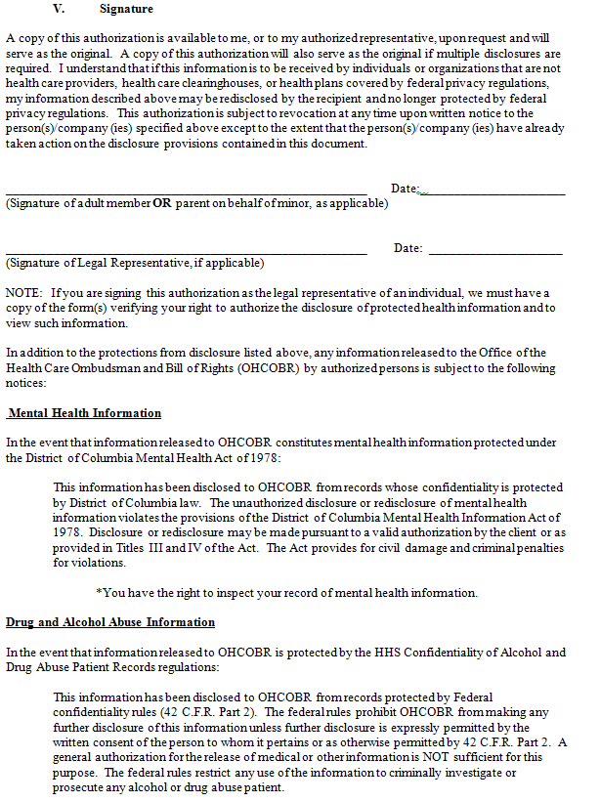
Form Requested to Begin Appeals Process
Authorization Form
Page 1
Page 2
Page 3
(Signature Page)

Slide 37
Review of Records and Research
Once Medical records are received from the insurer:
The policy is reviewed along with any other pertinent documents received;
Feedback is requested from DHCF staff, i.e. dentist, pharmacists, etc. and Clinical Subcommittee members;
Internet research is performed in support of the member’s case to be included in the external review, i.e., material found in Up-to-Date, medical journal publications, etc.; and
Medical records are requested from present and past treating providers to provide complete medical history to the external reviewers.

Slide 38
Mental Health Appeals
Types of Appeals
In-Patient Services | Out-Patient Services | Partial Hospitalization | Substance Abuse | Eating Disorders | Undetermined
14
 | 17
 |  | 2
 |  |  | 2
 |  |  |  | 1
 |  |  |  |  | 23
TOTAL |  |  |  |  | 59

Slide 39
Mental Health Appeals

Slide 40
Mental Health Appeals Outcomes
Outcome of Appeal
Adjusted | 2
Consumer Unresponsive | 2
Overturned | 6
Partial Payment | 5
Partial Overturned | 1
Pending | 10
Referred to DISB | 3
Referred to Other | 1
Referred Out-of-State | 2
Resolved-In Accordance with Policy | 1
Resolved-W/Out Use of Full Process | 4
Reversed-IPRO | 13
Upheld-Insurer | 1
Upheld-IPRO | 4
Withdrawn | 4
TOTAL | 59

Slide 41
Mental Health Appeals Outcomes

Slide 42
Mental Health Appeals Success Rate
How Case Closed
Successfully | 44
Unsuccessfully | 5
To Be Determined | 10
Total | 59

Slide 43
Helpful Links
Office of Health Care Ombudsman
www.healthcareombudsman.dc.gov
healthcareombudsman@dc.gov
(202) 724-7491 (Local)
(877) 685-6391 (Toll-Free)
U.S. Office of Personnel Management
www.opm.gov/healthcare-insurance
(202) 606-1800
Department of Insurance, Securities, and Banking
www.disb.dc.gov
disb@dc.gov
(202) 727-8000
Notes:
All websites listed are secure.

Slide 44
District of Columbia Department of Behavioral Health Behavioral Health Services for DC Employees and Their Families
Department of Insurance, Securities, and Banking
Mental Health Parity Forum
Thursday, May 12, 2022
12:00 Noon – 1:00 p.m

Slide 45
Behavioral Health is Health
Health is physical and mental
64% of people in treatment with DBH for substance use disorders also are treated for a mental health disorder
COVID-19 impacted the mental health of all of us which helped increase our understanding of mental and substance disorders as diseases, and decreased stigma
Prevention is possible and treatment works
Every day people recover

Slide 46
Advancing Whole Person Care and Health Equity
Advancing Health Care and Health Equity
The District of Columbia is a thriving community where prevention and recovery from substance use disorders and mental health conditions is possible and services and supports optimize a resident’s potential ability to function effectively within family and community.
Physical Health
Mental Health
Substance Use Treatment
Integrated
Care

Slide 47
D.C. Government Behavioral Health Resources for Employees
Behavioral health parity required in health insurance plans offered by the District Government
https://dchr.dc.gov/page/employee-benefits
Inova Employee Assistance for employees and eligible family members
Contact: (800) 346-0110 or www.inova.org/eap

Slide 48
Easy Access to Behavioral Health Services
Behavioral health services are easy to access by telehealth, face to face in certified community-based clinics, government service centers, and in public schools. DBH certifies community-based providers and monitors access and quality of care.
Mental Health services and supports
https://dbh.dc.gov/page/list-community-based-service-providers
Free Standing Mental Health Clinics
Call 888-793-4357 for a list of clinics
Federally Qualified Health Care Centers
https://findahealthcenter.hrsa.gov/
Substance Use Disorder Services and Supports
https://dbh.dc.gov/page/substance-use-disorder-services
School-based services in public & public charter schools
https://dbh.dc.gov/node/121802

Slide 49
Same Day Urgent Care Resources
Urgent Care Clinics
Adult clinic located at 35 K Street NE. Walk in between 8:30 a.m. – 3 p.m. for same day service
Contact: 202-442-4202
Child/youth clinic located at 821 Howard Road SE
Contact: 202-698-2611
Mobile Response
Community Response Team for adults who are unwilling or unable to go to a clinic
Contact: 202-673-6495
Children and Adolescent Mobile Psychiatric Service (ChAMPS) for children and youth ages 6-21 years
Contact: 202-481-1440
Comprehensive Psychiatric Emergency Program
Available 24 hours/7 days: This program provides emergency psychiatric care and referral to treatment.
1905 E Street SE Contact: 202-673-9319
Notes:
Sobering Center will be available for FY 2023

Slide 50
Talk to a Clinician Anytime

Slide 51
Suicide Prevention Lifeline
Suicide Prevention Lifeline
888-793-4357 (888-7-WE- HELP)
A trained clinician will answer the call and provide counseling support. The clinician will dispatch the Community Response Team or MPD if necessary.

Slide 52
Resources for individuals who live in Maryland or Virginia
Maryland Resources
Maryland Dial 211 or Text ‘Champs’ to 898-211
Virginia Resources
Virginia Mental Health of America Warm Line with Peers 1-866-400-6428 or
utilize the National Suicide Hotline 1-800- 273-8255
Virginia Substance Use Services: Contact Local Community Services Board https://dbhds.virginia.gov/community-services-boards-csbs/
National Resources
National Suicide Prevention Lifeline 1-800-273-TALK (8255)
SAMHSA 1-800-662-HELP (4357) Treatment Referral Routing Service

Slide 53
We All Can Combat the Opioid Epidemic

Slide 54
Thank you!
Patricia Thompson
Office of the Ombudsman
Department of Behavioral Health
patricia.thompson@dc.gov
844-698-2924

